Slide 1
NIGIWAI

Slide 2
Nigiwai python code
For the Nigiwai python code, I made minors modifications.
Now, we only put a filename e.g, “Shopping_circulate.txt” without ‘.._ROI.txt’
The code re-labels the fixed pedestrians ID (ROI) according to the max number of the moving pedestrians
It gives two outputs of nigiwai in each frame :
Nigiwai summation of the moving pedestrians
Nigiwai summation of the ROI pedestrians (fixed)

Slide 3
VADERE
I tried to create shopping and passing scenarios with same density.
The idea is to make people circulate in the passing scenario.
However, I did not make this exactly because, the target changer could not be used twice, so I used many target changers.

Slide 4
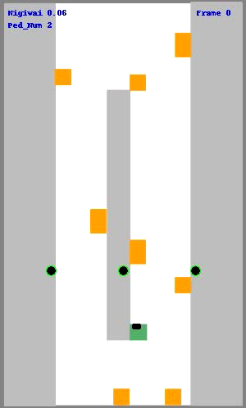
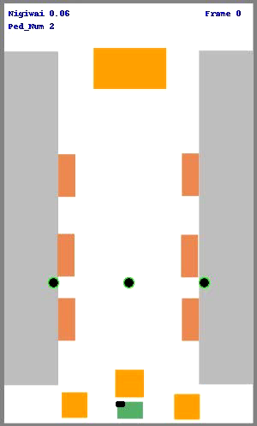
Passing vs Shopping
Passing
shopping
Both scenarios have same entering rate, so the number of pedestrian in each frame are same.

Slide 5
Passing vs Shopping
The summation of Nigiwai of moving pedestrian in each frame is drawn for both passing and shopping scenarios

Slide 6
Passing vs Shopping
The summation of Nigiwai of fixed pedestrian (ROI) in each frame is drawn

Slide 7
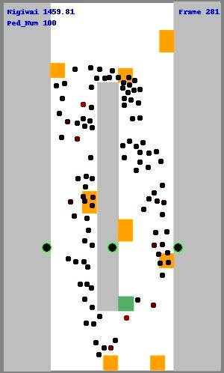
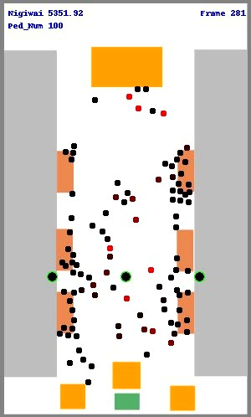
Passing vs Shopping (2)
Passing
shopping
Repeat previous scenarios but the entering source is stopped after 2/3 of the total duration (frame 250).
So number of ped becomes fixed after frame (250)

Slide 8
Passing vs Shopping (2)
The summation of Nigiwai of moving pedestrian in each frame is drawn for both passing and shopping scenarios

Slide 9
Passing vs Shopping (2)
The summation of Nigiwai of fixed pedestrian (ROI) in each frame is drawn

Slide 10
Conclusion and discussion
I want to know your opinions about the created scenarios are they representing shopping and passing scenarios or not, i.e., what the criteria to say that a scenario represents passing or Nigiwai.
If so, I can create many different scenarios for shopping and Passing for comparisons.
Maybe the next step is to create a uniform distributed fixed points (ROI), then we can expect a Nigiwai for those points having high accumulated scores and compared to the shopping locations.

